Slide 1
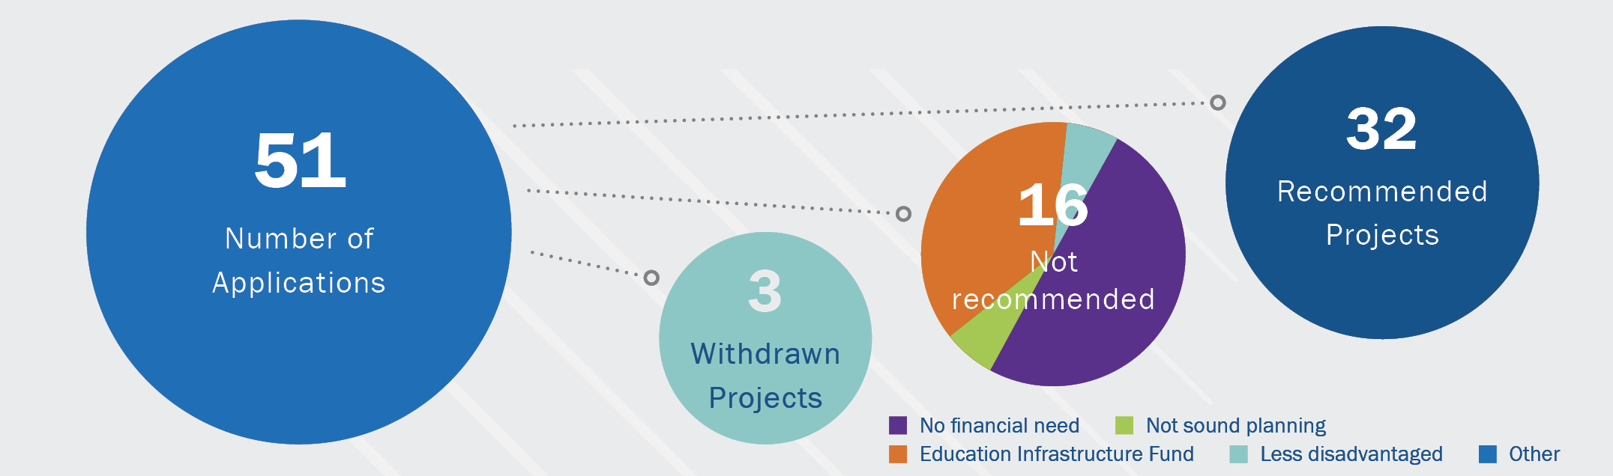
2021 CGP Application Summary
Application Overview
16
Not
recommended
Application Overview
5
Number of Applications
16
No
recommended

Slide 2
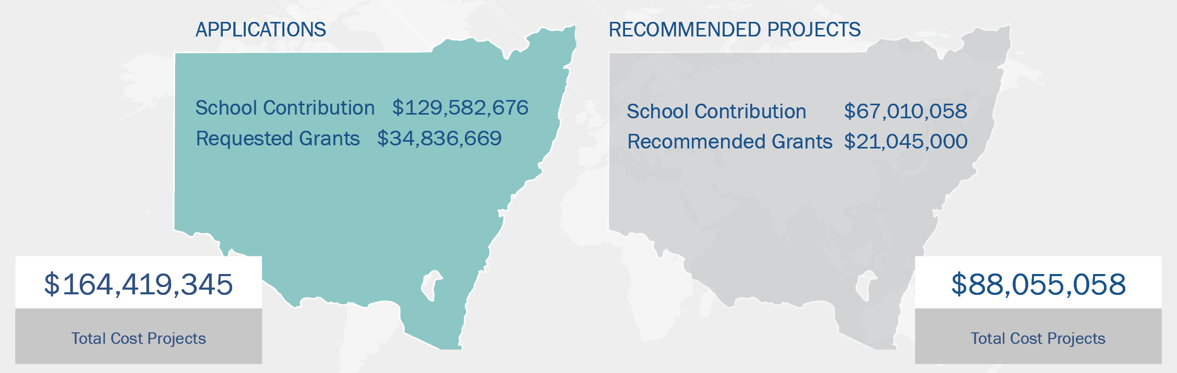
2021 CGP Application Summary
Funding Overview

Slide 3

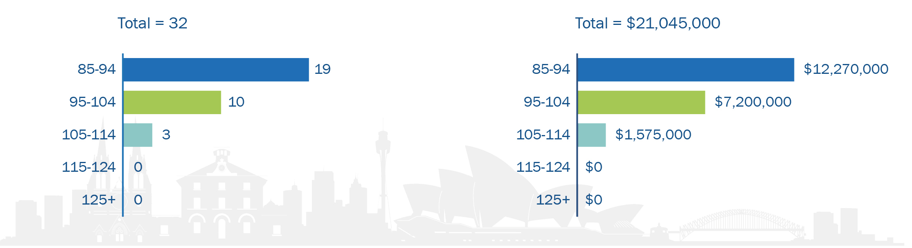
2021 CGP Application Summary
Grant Funding by School Location
Projects by DMI Band Grant Funding by DMI Band

Slide 4
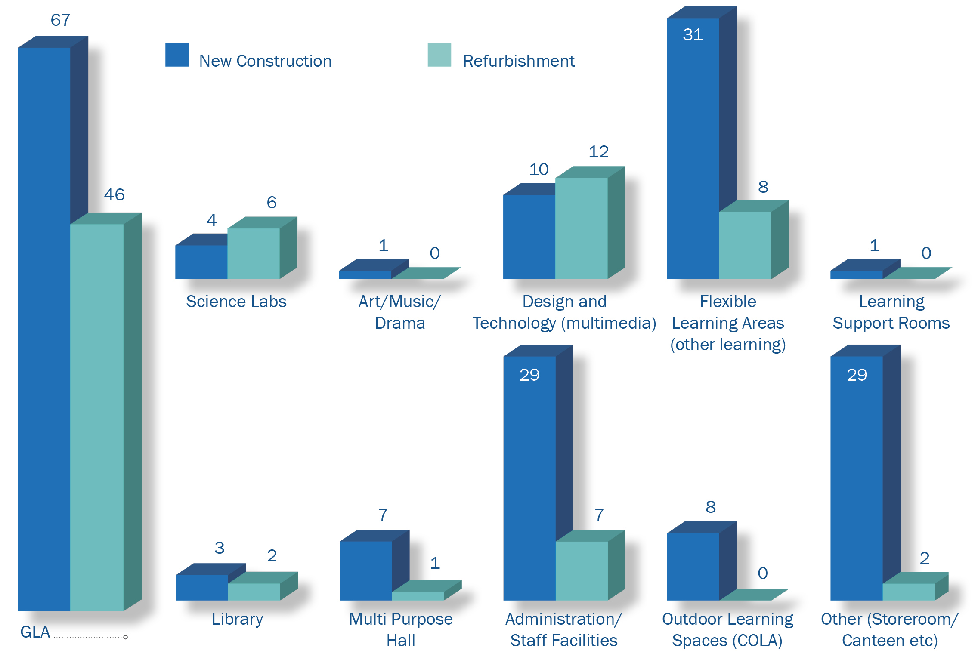
2021 CGP Application Summary
Facilities Recommended

