Slide 1
2022 CGP Application Summary
Notes:
TO BE UPDATED with 2022 application data

Slide 2
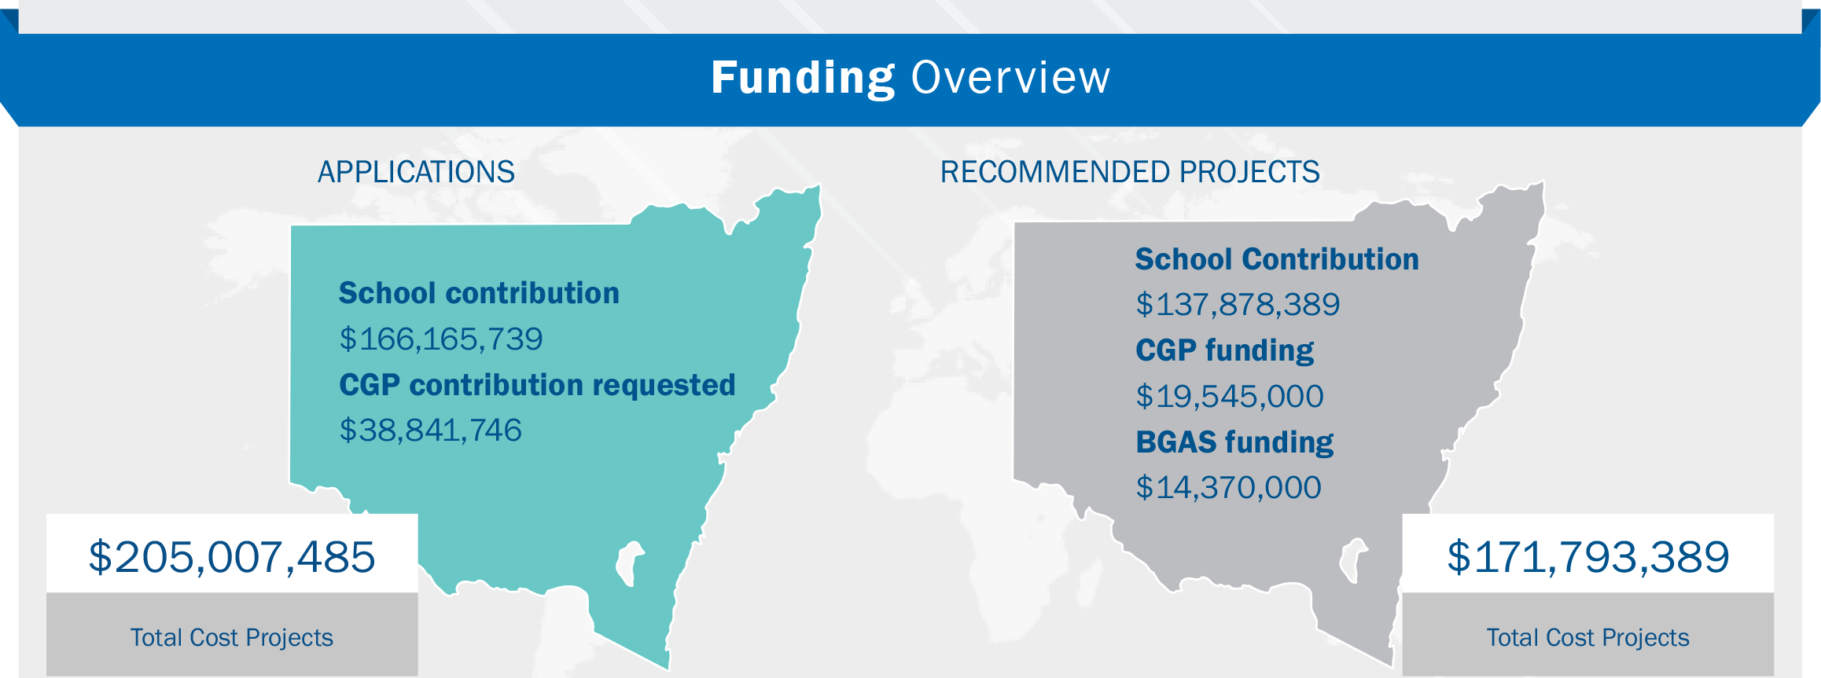
2022 CGP Application Summary
Notes:
TO BE UPDATED with 2022 application data

Slide 3
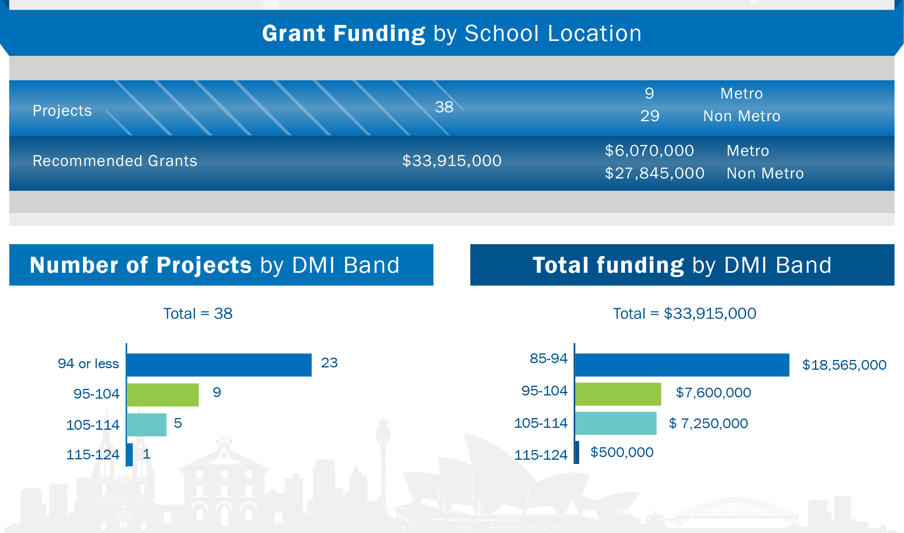
2022 CGP Application Summary
Notes:
TO BE UPDATED with 2022 application data

Slide 4
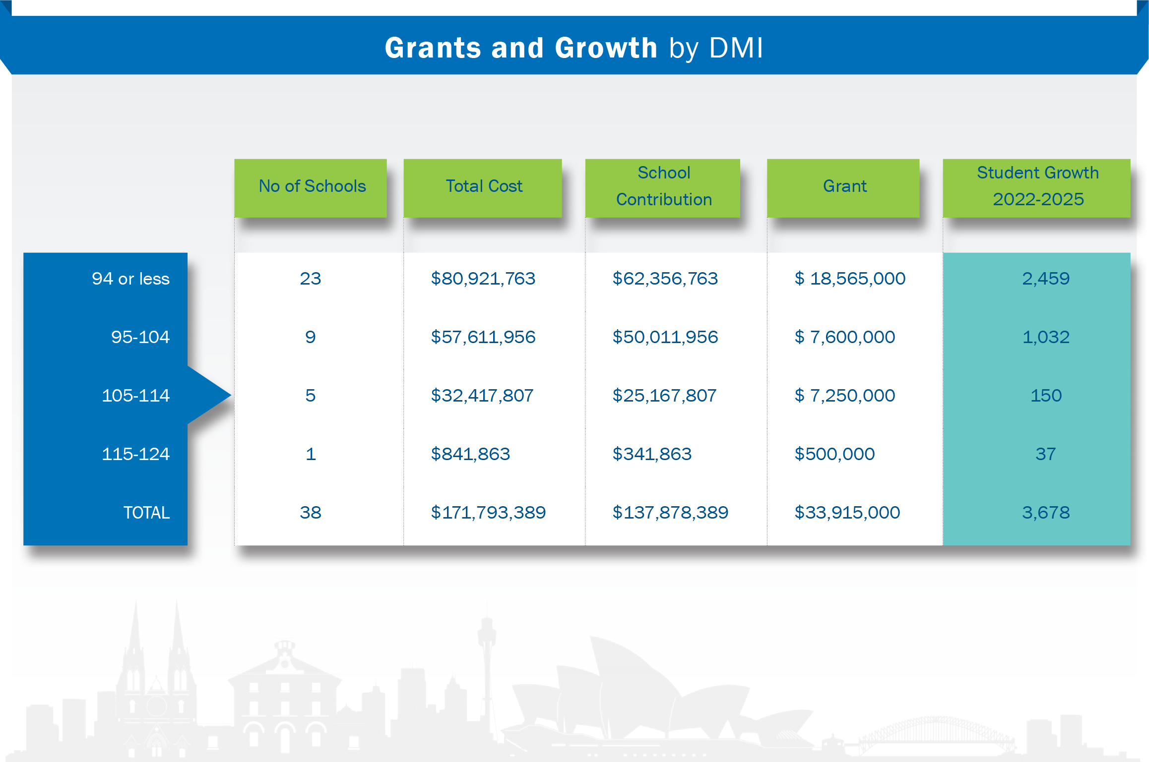
2022 CGP Application Summary
Notes:
TO BE UPDATED with 2022 application data

Slide 5
2022 CGP Application Summary

