Slide 1
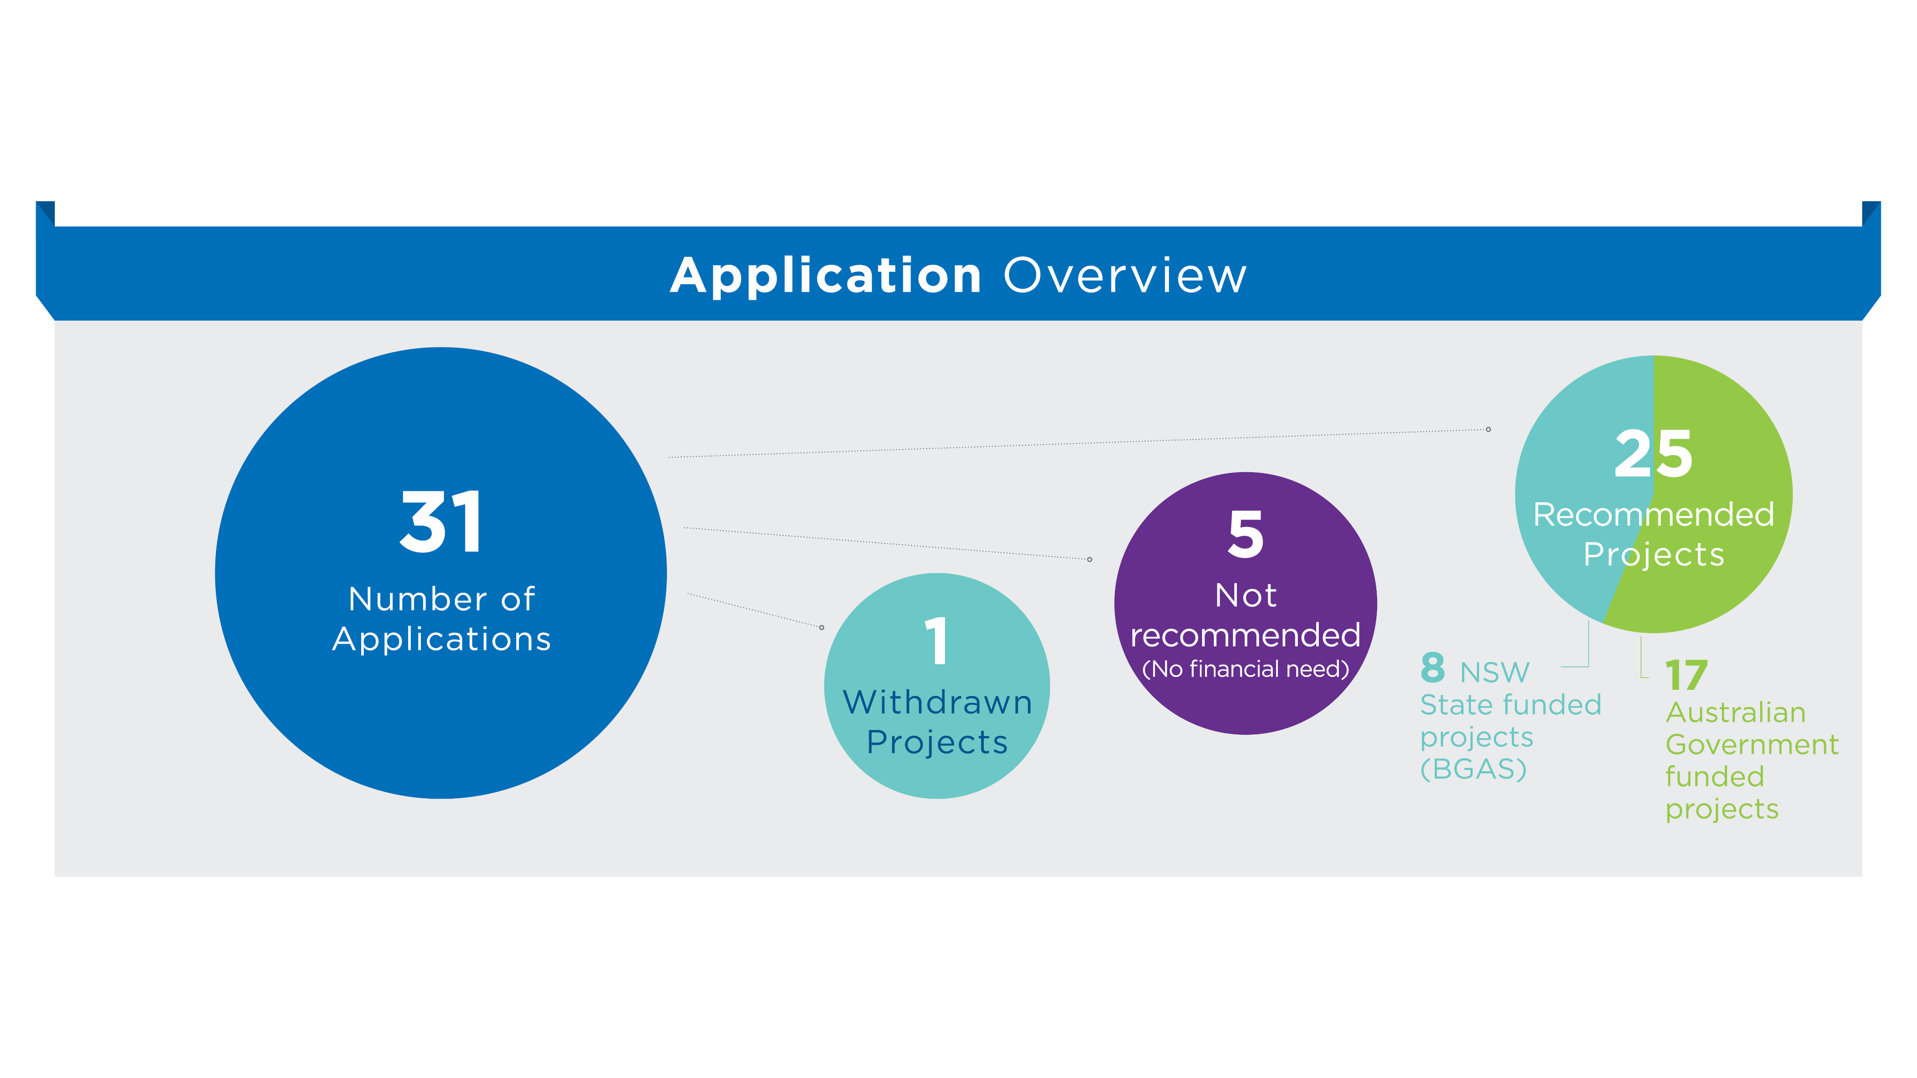
2023 CGP Application Summary
Notes:
TO BE UPDATED with 2022 application data

Slide 2
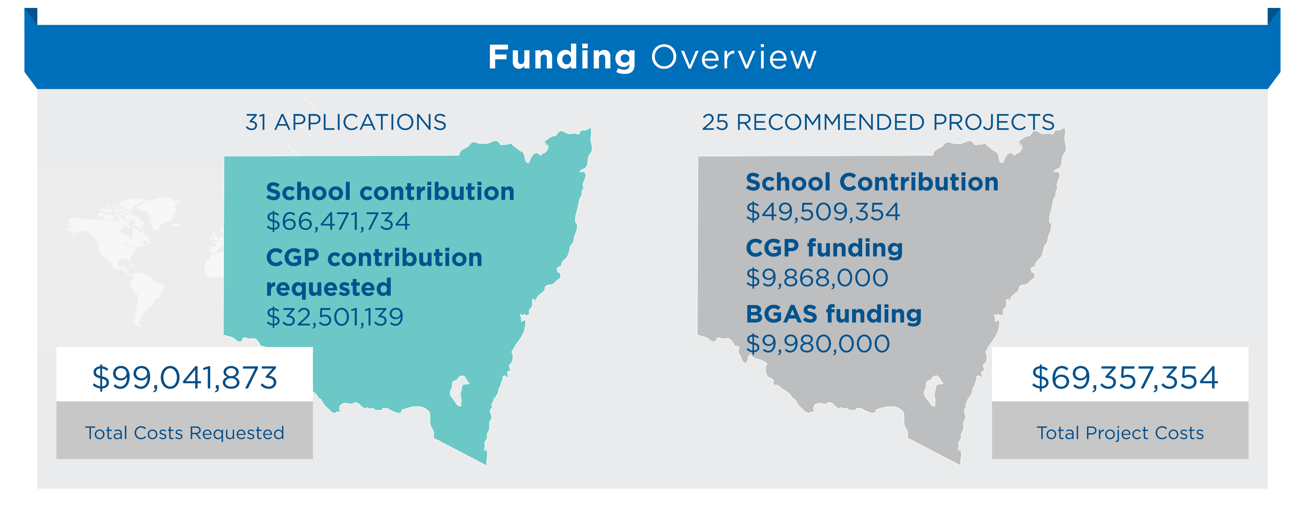
2023 CGP Application Summary
Notes:
TO BE UPDATED with 2022 application data

Slide 3
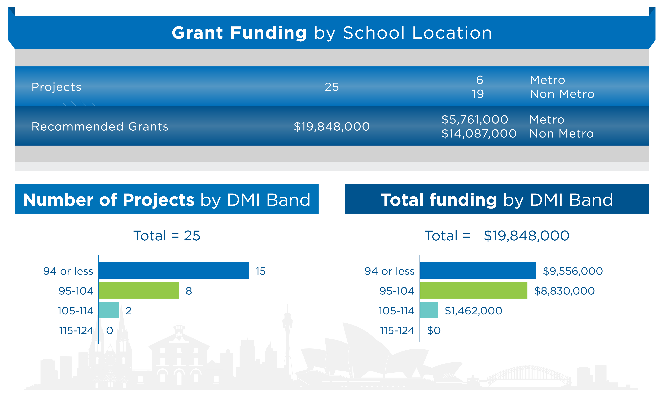
2023 CGP Application Summary
Notes:
TO BE UPDATED with 2022 application data

Slide 4
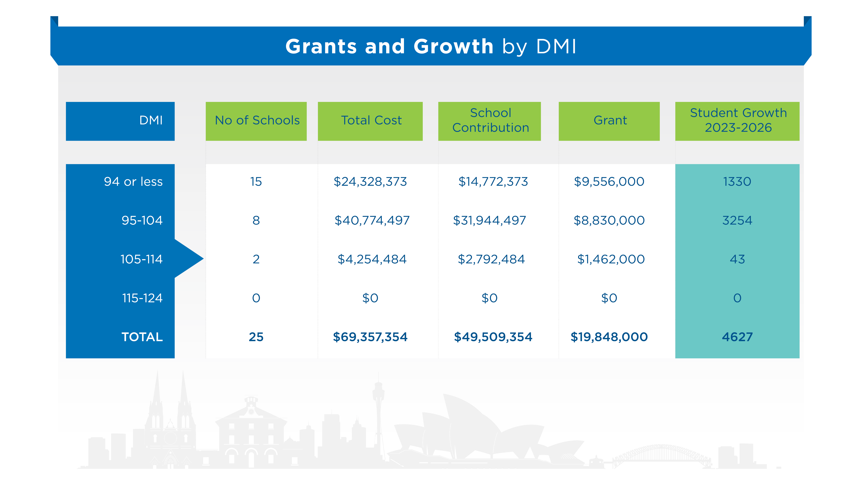
2023 CGP Application Summary
Notes:
TO BE UPDATED with 2022 application data

Slide 5
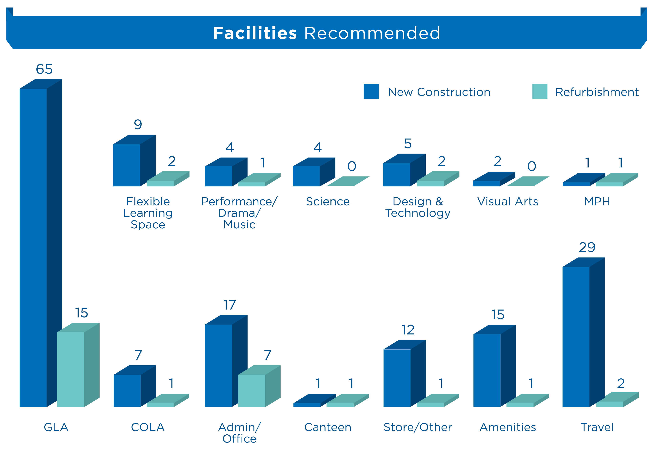
2023 CGP Application Summary

